Slide 1
Comprehensive Comparison of RDBMS and NoSQL Databases for Healthcare Applications TERM PROJECT
DATA 225 DB Systems for Analytics
Group 1:
Swetha Subramanian
Revathi Boopathi
Madhura Pandit

Slide 2

What is the problem?
Healthcare Insurance Recommendation Application
Selecting an Optimal and Economical Insurance plan for patients
A Faster performing database to organize systematic data capture with accuracy and lesser delays
Finding a suitable database for Medical Insurance Recommendation Application.

Slide 3
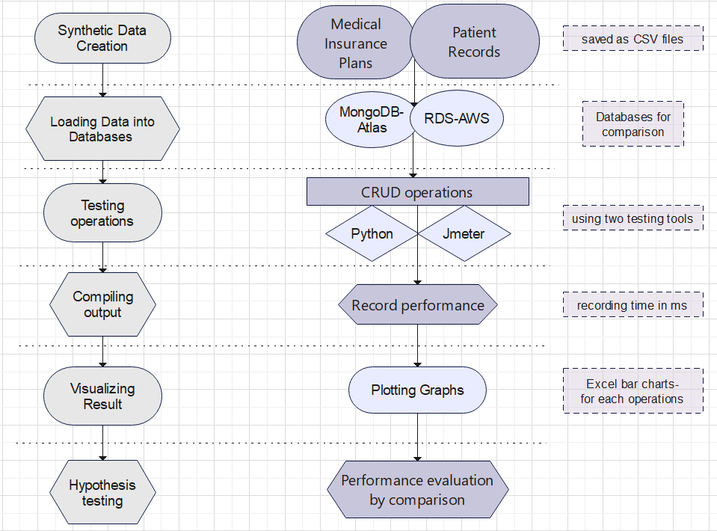
Process Design:
Insurance – ~300k records
Patients – 150k records
Cloud database comparison undertaken.
Operations repeated 20 times to improve accuracy of results (Benchmarking tools explored)
Measured timestamp pre and post the observation
Observed results of Python and JMeter separately
Validated and quantified the hypothesis through insights generation

Slide 4
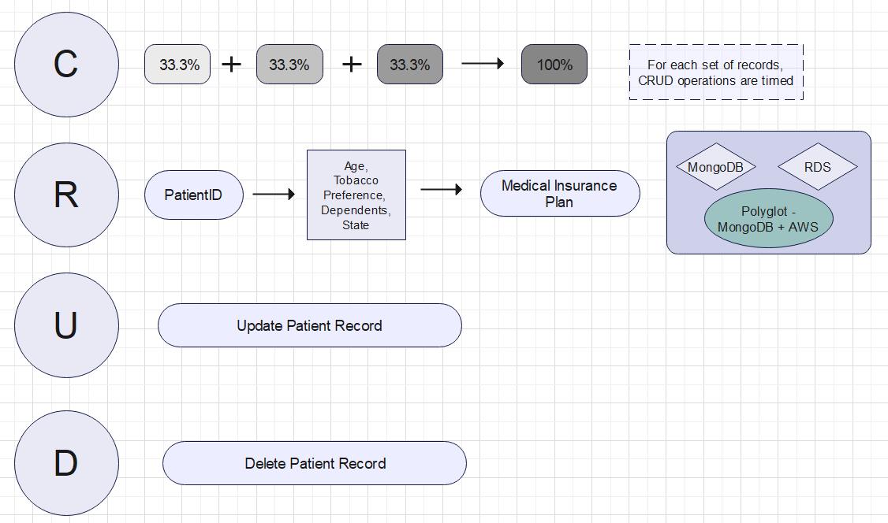
Output Generation:
Wait! Polyglot?
MongoDB → Insurance data
(Huge data, AP model needed for our use case)
AWS RDS → Patients data (Concurrency and consistency is critical - ACID)
Note
Workload 1 – Insurance data (100k), Patients (50k)
Workload 2 – Insurance data (200k), Patients (100k)
Workload 3 – Insurance data (300k), Patients (150k)

Slide 5
Experiments
Experiments are carried out in Python and JMeter
Sr.No | Operations | Task | AWS RDS | Mongo Atlas | Polyglot (Mongo + RDS)
1 | Create | Load both data to the respective databases
2 | Read | Take a patient from one table as an example and provide a list of suitable Insurance plans using insurance data (Explains problem use case)
3 | Insert | Insert a Patient record to the patient data
4 | Update | Make changes to the number of dependents in the patient data as it’s subject to change over time
5 | Delete | Delete a patient record who no longer exists in the system
Note
While performing these operations, time of execution is measured in both JMeter and Python
Read, insert, update and delete has been performed for 1 record
Data load wasn’t performed using JMeter
- Implemented
- Not Implemented

Slide 6
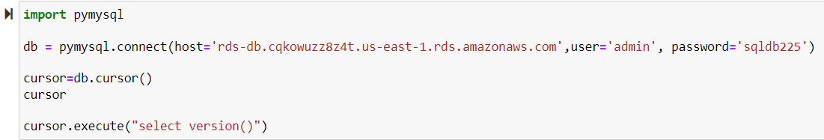
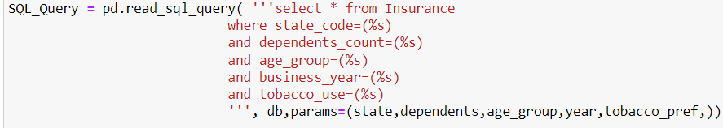
Python Sample Code Demo (AWS RDS)

Slide 7
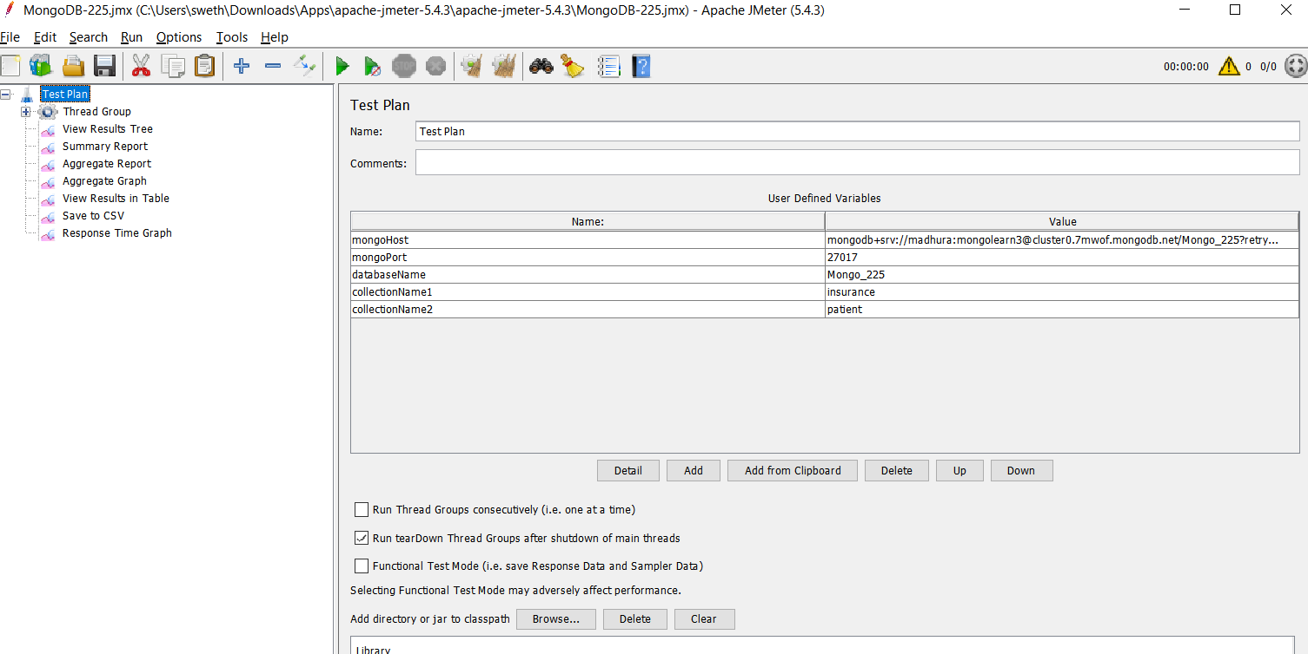
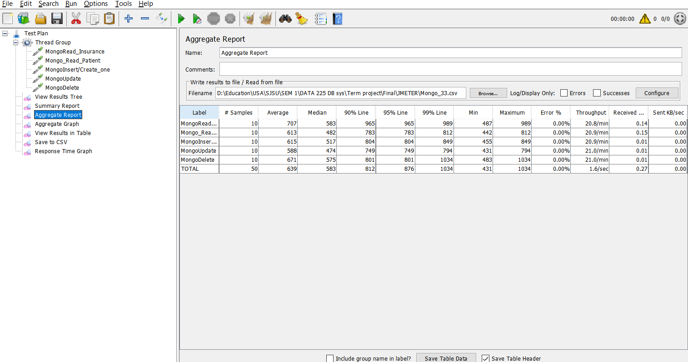
JMeter Sample Code Demo (MongoDB)

Slide 8
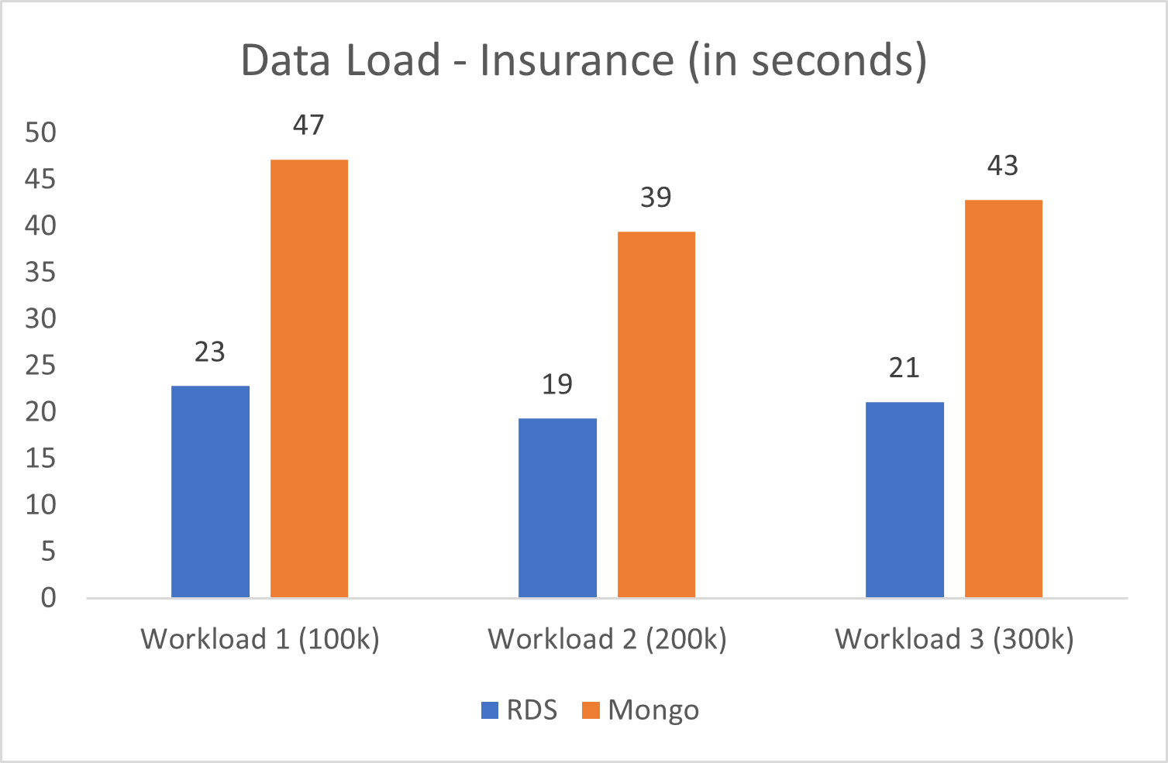
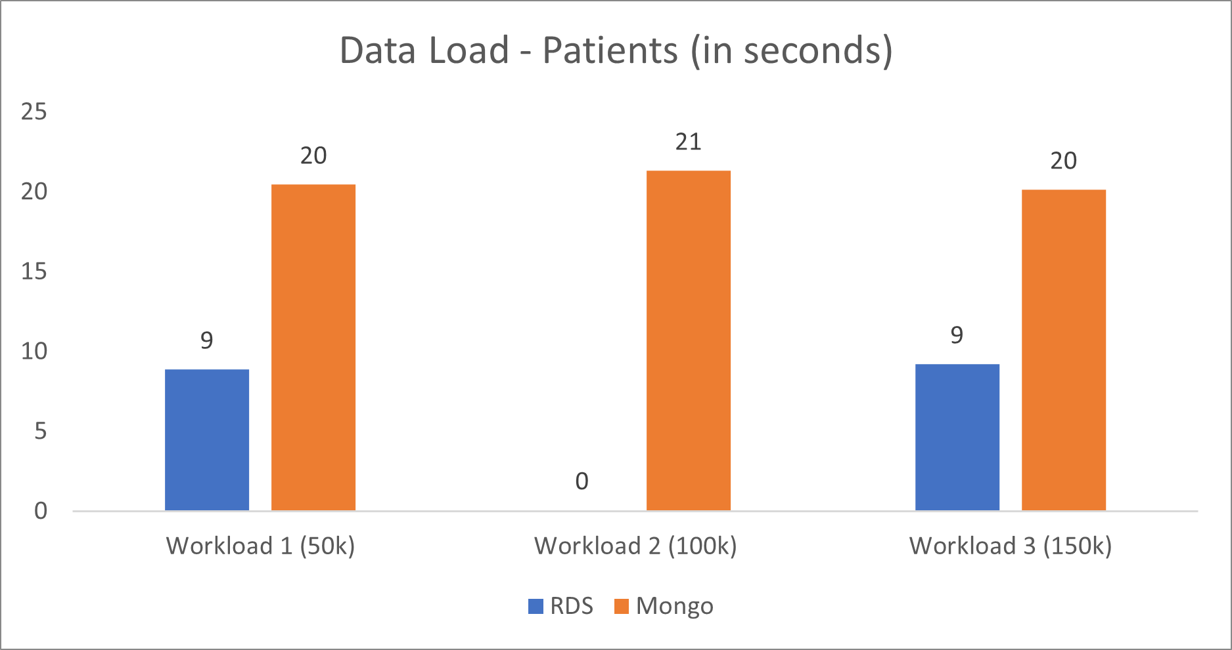
Output Analysis
Create/Load
Read
Insert
Update
Delete
Observations
MongoDB seems to take time for load through python – Anomaly! (Needs further investigation)
This is overcome on loading data directly through Mongo Atlas and Compass (in milliseconds) which was faster compared to Python

Slide 9
Output Analysis
Create/Load
Read
Insert
Update
Delete
Observations
MongoDB and Polyglot approach works better as compared to RDS as per the expectation in Python,
JMeter shows fluctuating results, specifically for MongoDB and Polyglot – Anomalous!
Results seem to increase in proportion to the workload in the case of JMeter

Slide 10
Output Analysis
Create/Load
Read
Insert
Update
Delete
Observations
MongoDB takes lesser time compared to RDS for insert operation as per the expectation in Python
MongoDB takes more in the case of JMeter – Anomalous!

Slide 11
Output Analysis
Create/Load
Read
Insert
Update
Delete
Observations
MongoDB takes lesser time compared to RDS for update operation as per the expectation in Python
MongoDB takes more in the case of JMeter – Anomalous!

Slide 12
Output Analysis
Create/Load
Read
Insert
Update
Delete
Observations
MongoDB takes lesser time compared to RDS for delete operation as per the expectation in Python
MongoDB takes more in the case of JMeter – Anomalous!
Results seem to increase in proportion to the workload in the case of JMeter

Slide 13
Comparing Output Against Hypothesis
Hypothesis 1: Using a NoSQL and Polyglot for any application is always better than a traditional RDBMS for CRUD operations
Test 1: Compare the time taken by create, read, update and delete operations with the 2 types of databases
Observations: MongoDB and Polyglot perform better for read, update, insert and delete operations whereas they do not perform as good for data load. This might be attributed to the minimal size of the data and because of that we cannot get any concluding results
Hypothesis 2: Using a benchmarking tool makes the database comparison process seamless compared to leveraging traditional application-based comparison
Test 2: Compare the executional implications of comparison process across Python based comparison method vs JMeter
Observations: Benchmark tool JMeter was user friendly, automates results, has own visualization, showed multiple inbuilt metrics and significantly reduced the turnaround time for comparison

Slide 14
Abnormal case explanation
Anomaly 1: RDS performs better for data load as compared to Mongo which is not expected, this may be attributed to the less data size
Anomaly 2: JMeter execution times are better in the case of RDS and not very good with MongoDB, This might be attributed to the compatibility of JMeter to SQL as it supports the inbuilt SQL queries and not in the case of MongoDB which supports only Java and Groovy language

Slide 15
Discussion
The experiments conducted above prove that, overall, the performance of MongoDB is better than that of RDS, except in case of Load operation
The Polyglot approach worked the best for read operation in comparison to the individual databases
In case of insurance plan recommendation, where read operation is of utmost importance, Polyglot would be the best choice

Slide 16
Summary and Conclusions
The Polyglot model is suitable and suggested for this kind of data model which leverages the advantage of each of the database.
We used insurance data hosted in MongoDB because of its big size and least consistency requirements
However, the patient data hosted in AWS RDS works better because of concurrency and its consistency requirement

Slide 17
Recommendations for Future Studies:
Business Improvisations:
Increase the number of insurance plan selection attributes for the patient to make the model robust
Data Improvisations for Future:
Increase data size and number of experimentations for accurate results and insights
Explore JMeter further to handle data load and multi record operations
Experiment on availability, consistency and concurrency to check how the system responds and observe specific characteristics
Stress testing with JMeter
Finding best method to upload data to RDS (AWS S3 with LAMBDA fun)
Experiment with number of users to stress test read heavy situations

Slide 18
Thank you!

